Slide 1
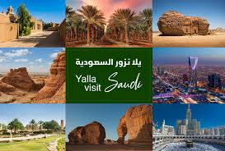
Tourist Guide website in the Saudi Arabia

Slide 2
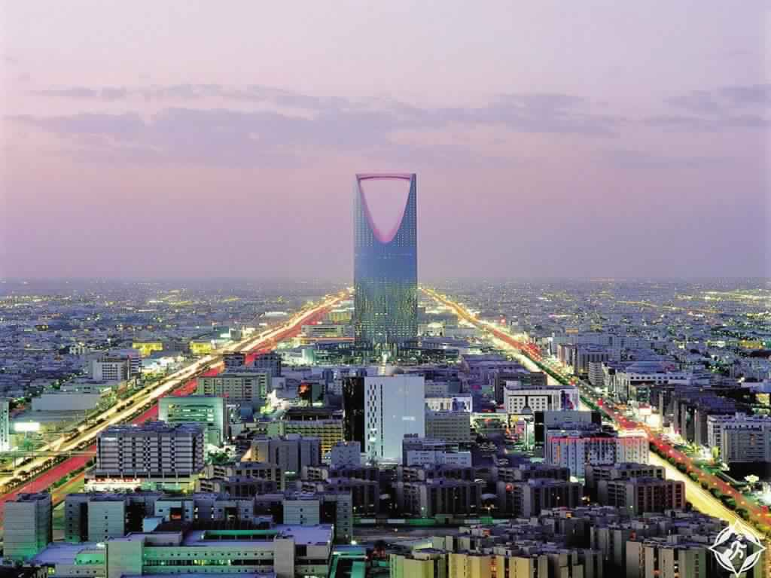
AbsTRACT
The Tourist Guide website aims to provide comprehensive and helpful information to tourists during their trips to Saudi Arabia. It makes it easier for tourists to guide them to tourist places.

Slide 3
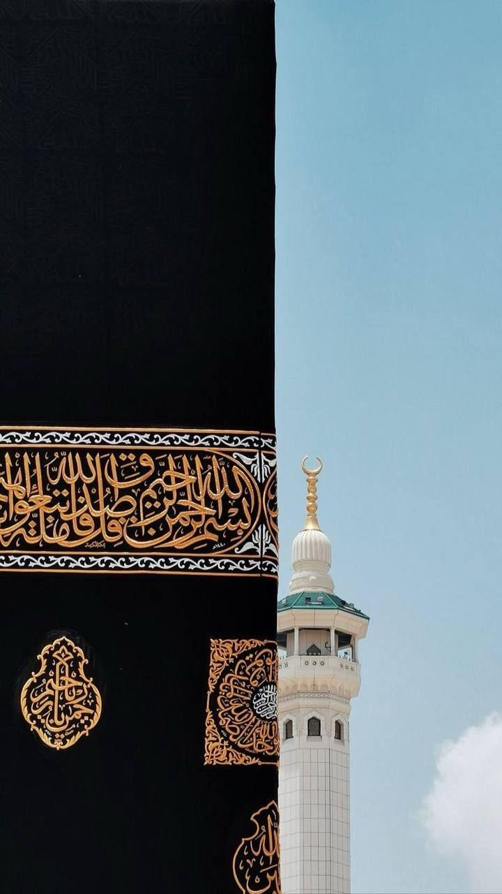
Problem statement
The lack of unified website that provide a tourist guide and there is no support the
tourism sector that include all the places that a tourist can go to.

Slide 4
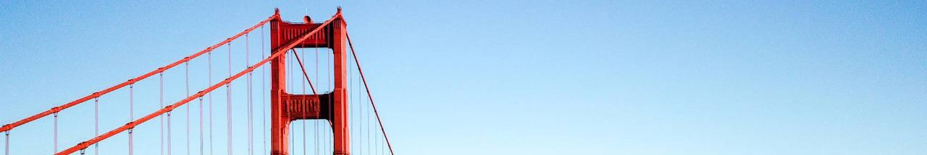
Objectives
The website will provide Information on tourist attractions which have description of the main tourist attractions with historical and cultural information.
The website will provide Guide to Restaurants and Cafes which provides information about a variety of food options including local specialties.
The website will provide Shopping information which directing tourists to local shopping and places and traditional markets.

Slide 5

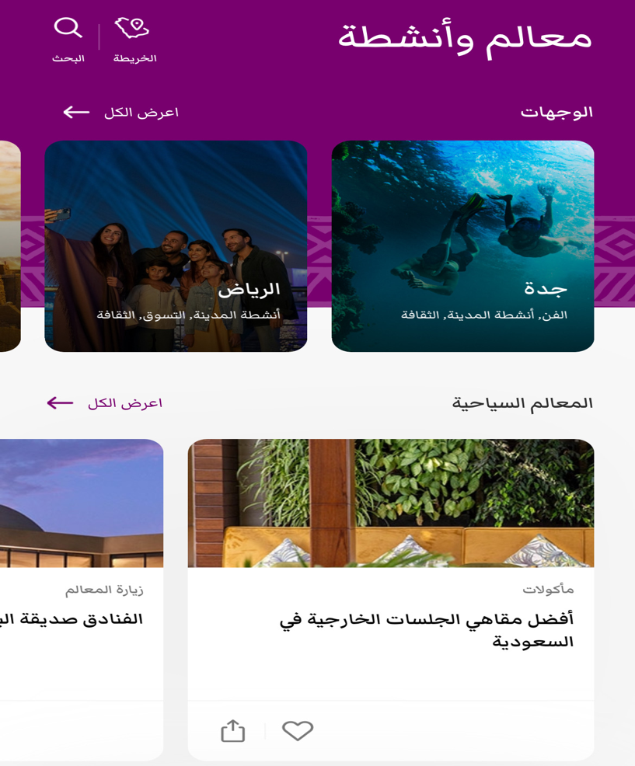
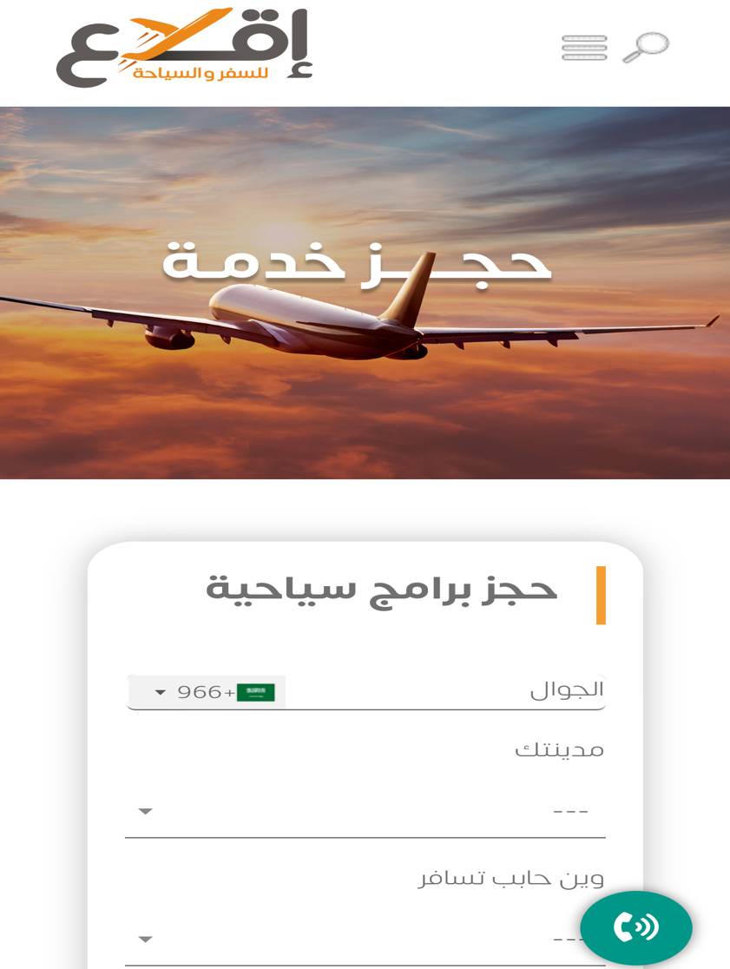
Related work
The Jawlah application
Rooh Saudi Arabia application
Iqlaa website.

Slide 6
Website design and languages ​​used
We began by identifying the lack of support for the tourism sector, which includes various destinations and tourist attractions. We have conducted extensive research on cities and hotels to gather information relevant to our website. We then created a use case for the site and set out to address the problem comprehensively. This included creating a preliminary site design. Using HTML, CSS and JavaScript, we designed a 5-page website. Finally, we conducted extensive testing to ensure that the site worked properly.

Slide 7
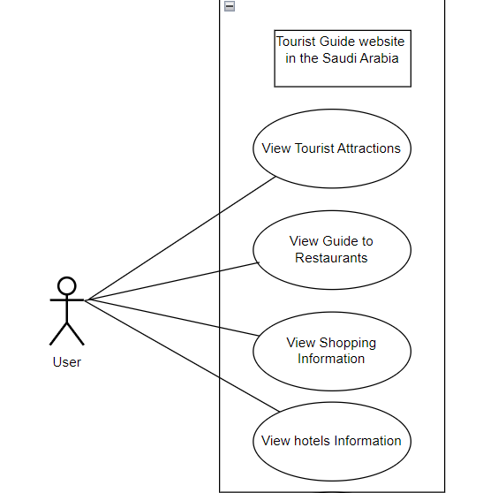
Use case

Slide 8
Result
The result of our work is a site that offers its users the best tourist places in the
Kingdom of Saudi Arabia, whether they are upscale hotels, distinctive cafes, delicious
restaurants, or interesting markets. The project's outcomes contribute to the
advancement of the tourism industry within the Kingdom, providing a platform that
enhances the tourist experience and promotes the exploration of its diverse cities

Slide 9
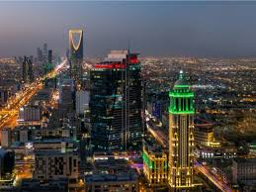
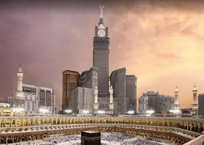
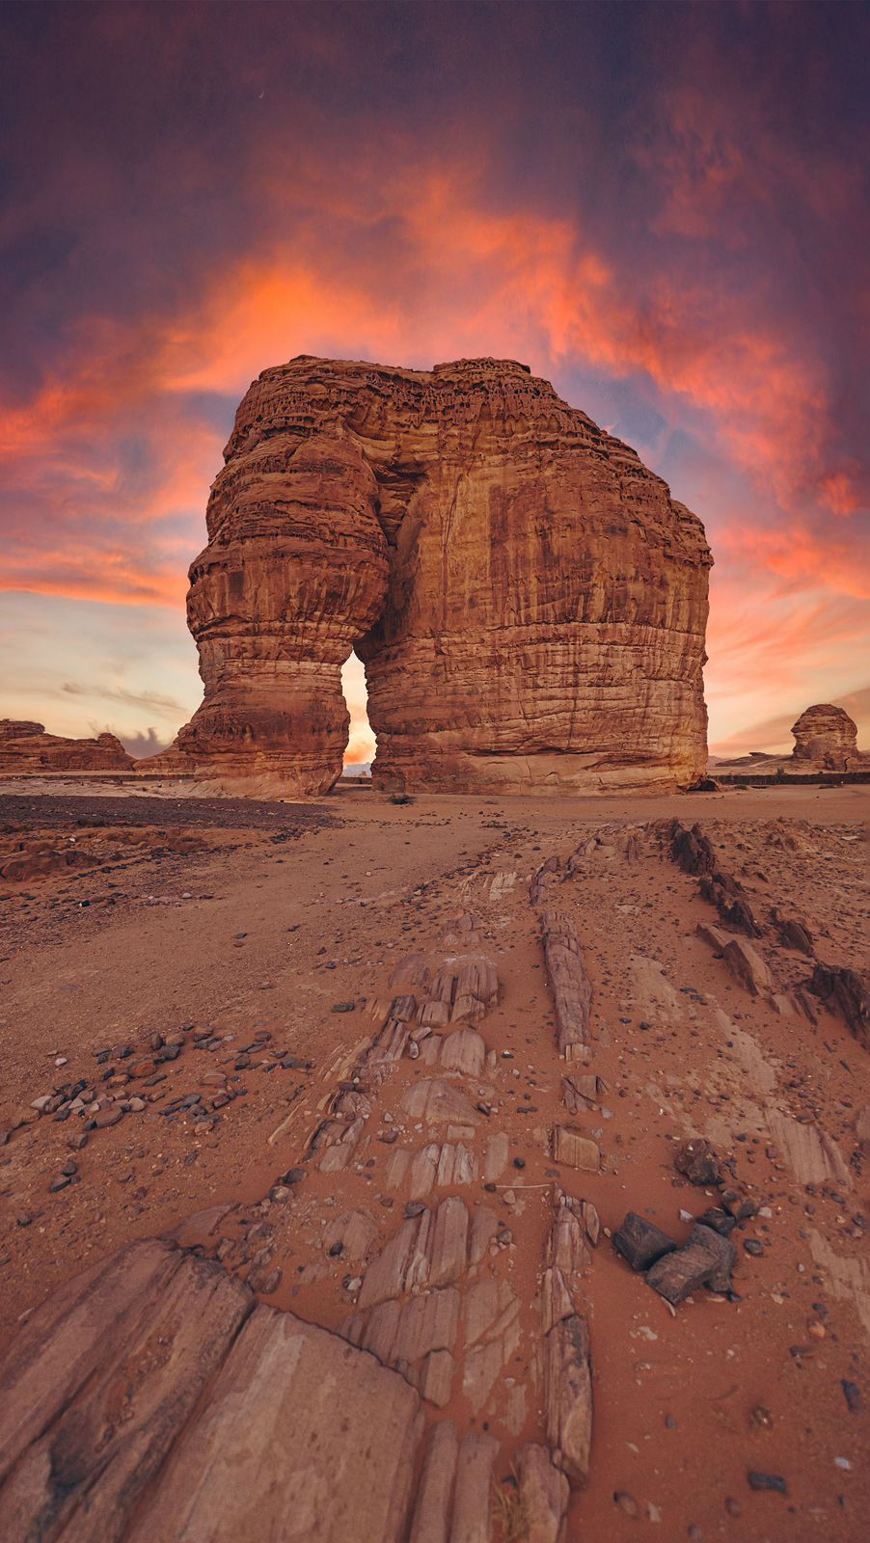
Nada Murayhil Albalawi | 441008330
Nashwa Eid Al-Juhani | 441006700
Abeer Suleiman Al-Atwi | 441004545
Reem Salem Al-Qarni | 441007012
Thank…

